Slide 1
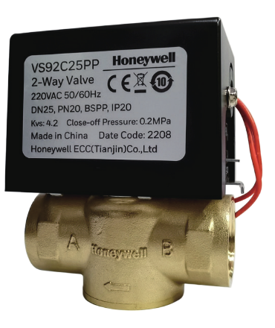
VS9 vs VS8
Actuator | VS9
Operating voltages | 220Vac+/-10% 110Vac+/-10% 24Vac+/-10%
Control Mode | On-Off, Spring return, normally closed when powered off
Operating Temp&Humidity | 0~50°C, 10%~90% RH non-condensating
Operating Time | Open:≤20s; Close::≤15s;
Protection Rating | IP20
Valve | VS9
Applicable medium | cold, hot water or 50% glycol solution
Fluid temperature | 0~94˚C
Nominal pressure | PN20
Leakage Rate | 0.05% Kvs
Materials | Valve body: HPb59-2 Valve rod: HPb59-2 Valve flap: EPDM
VS9

Slide 2
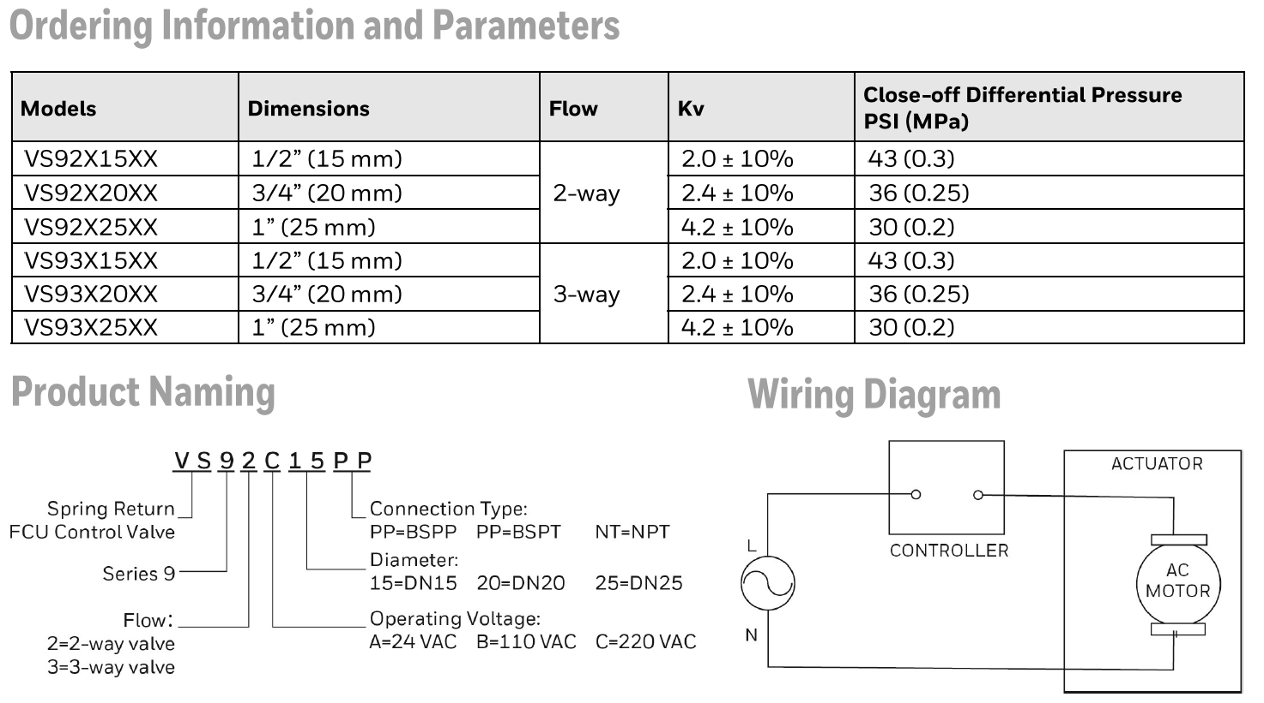
VS9 SELECTION GUIDE

Slide 3
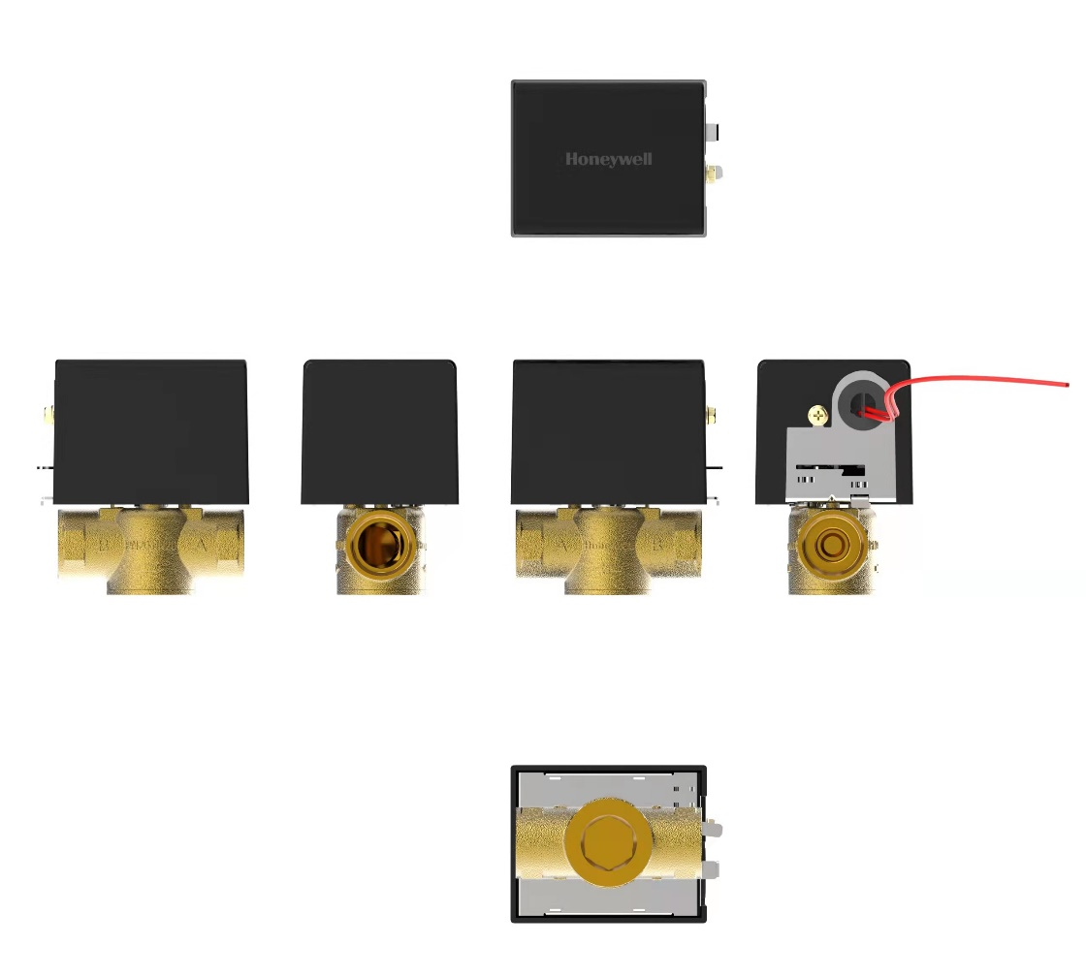
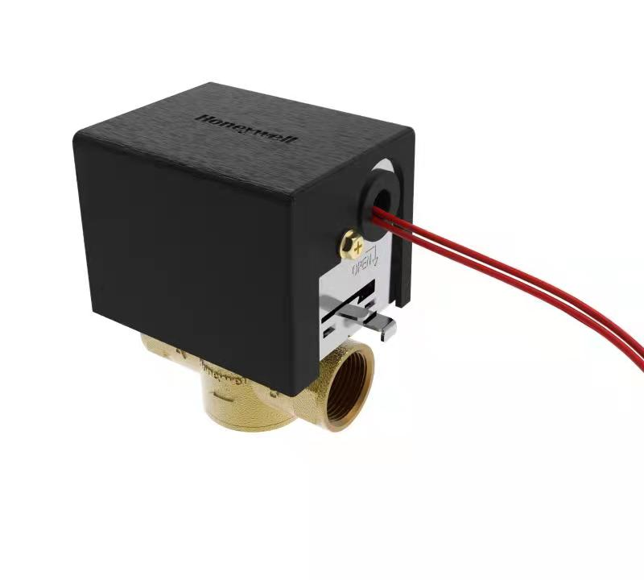
VS9 images

